Slide 1
Short Propositional Proofs are Hard to Find: a Meta-Complexity Approach
Faculty of Information Engineering, Computer Science and Statistics
Master’s Degree in Computer Science
Sapienza University of Rome
Academic year • 2025/2026
Candidate • Simone Bianco
Advisors • Nicola Galesi, Massimo Lauria

Slide 2
What is proof complexity?
𝝋
accept!
formula
Q
time poly( |𝜑| + |𝜋| )
some 𝜋 accepted ⬌ 𝜑 ∊ TAUT
𝝅
reject
candidate proof
How long must 𝜋 be with respect to |𝜑| = n ?
Short Propositional Proofs are Hard to Find: a Meta-Complexity Approach - Simone Bianco

Slide 3
Two examples
Resolution
Lines are propositional clauses
Polynomial Calculus
Lines are polynomials, read as p = 0
C ∨ x D ∨ ¬x
C
p q
p
C ∨ D
C ∨ x
𝛼p + 𝛽q
x ᐧ p
Cut
Weakening
Linear combination
Multiplication
e.g.
(¬x₁ ∨ x₃ ∨ x₂ ), (¬x₁ ∨ x₄ ) ⊢ (x₃ ∨ x₂∨ x₄ )
axioms
x² - x = 0 (forces x ∊ {0,1})
Short Propositional Proofs are Hard to Find: a Meta-Complexity Approach - Simone Bianco

Slide 4
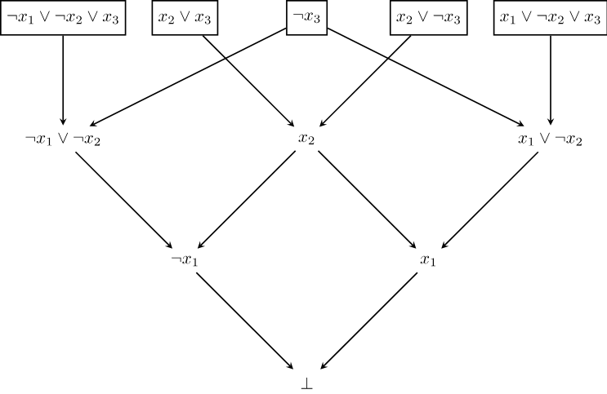
A Resolution refutation
Short Propositional Proofs are Hard to Find: a Meta-Complexity Approach - Simone Bianco

Slide 5
Why finding short proofs matters
Theory: a route towards NP ≠ coNP
Practice: solvers produce proofs
NP ≠ coNP
𝝋
UNSAT
CDCL
SAT solver
UNSAT
(answer)
the run log yields
All systems have a 𝜑 such that |𝜋| >> poly(n)
Resolution refutation of 𝝋
run-time ≥ |𝜋|
Short Propositional Proofs are Hard to Find: a Meta-Complexity Approach - Simone Bianco

Slide 6
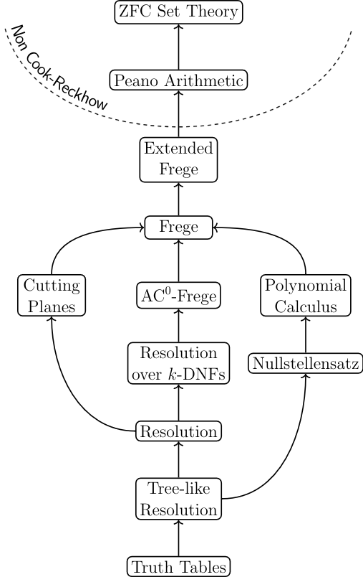
The zoo
Short Propositional Proofs are Hard to Find: a Meta-Complexity Approach - Simone Bianco

Slide 7
The zoo
Logic-based systems
Short Propositional Proofs are Hard to Find: a Meta-Complexity Approach - Simone Bianco

Slide 8
The zoo
Logic-based systems
Algebraic systems
Short Propositional Proofs are Hard to Find: a Meta-Complexity Approach - Simone Bianco

Slide 9
The zoo
Logic-based systems
Algebraic systems
Geometric systems
Short Propositional Proofs are Hard to Find: a Meta-Complexity Approach - Simone Bianco

Slide 10
Two properties
implies
Automatability
Feasible interpolation
Can we find short proofs for formulas?
Can we extract interpolants from proofs of split formulas?
𝜋
refutation of
𝝋(x, y) ∧ 𝜓(x, z)
𝝋
A
search algorithm
𝜋
proof of 𝝋
used to build
𝝋(𝛼, ᐧ )
UNSAT
𝛼
I
interpolant
𝜓(𝛼, ᐧ )
UNSAT
common assignment
run-time:
poly(n)
Short Propositional Proofs are Hard to Find: a Meta-Complexity Approach - Simone Bianco

Slide 11
What is known?
Non-automatable
No feasible interpolation unless Diffie-Hellman fails
(Quasi) Automatable!
Short Propositional Proofs are Hard to Find: a Meta-Complexity Approach - Simone Bianco

Slide 12
What is known?
Non-automatable
No feasible interpolation unless Diffie-Hellman fails
Non-automatable
Unless P = NP (or unless ETH fails)
(Quasi) Automatable!
Short Propositional Proofs are Hard to Find: a Meta-Complexity Approach - Simone Bianco

Slide 13
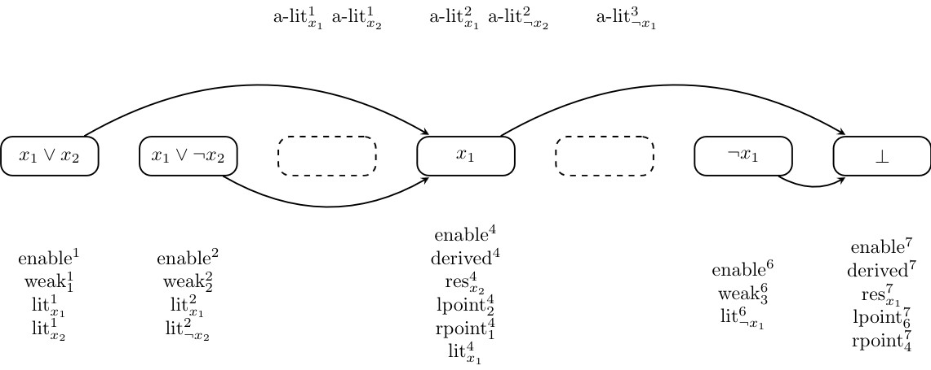
A Meta-Complexity Approach
The Refutational Formula
Ref_{s}(𝝋) encodes the statement “𝝋 has a Resolution refutation of size at most s”
Short Propositional Proofs are Hard to Find: a Meta-Complexity Approach - Simone Bianco

Slide 14
A Meta-Complexity Approach
When 𝝋 is satisfiable
Ref_{s}(𝝋) has polynomial size Res-refutations
When 𝝋 is unsatisfiable
Ref_{s}(𝝋) requires exponential size Res-refutations
SAT
refutation found
𝝋
build in poly(n)
Ref_{s}(𝝋)
automate
for poly(n) steps
UNSAT
time runs out
Short Propositional Proofs are Hard to Find: a Meta-Complexity Approach - Simone Bianco

Slide 15
New contribution
Size improvement
generalizing results for Ref_{s}(𝝋) to other values of s
System improvement
extending results for Ref_{s}(𝝋) to an algebraic proof system
before
only s = n²
before
in Resolution
now
every s ≥ n²
now
in Polynomial Calculus with Resolution
simpler proofs for known results
algebraic systems previously used variants of Ref_{s}(𝝋)
one formula Ref_{s}(𝝋) • for any s ≥ n² • in Resolution and PCR
Short Propositional Proofs are Hard to Find: a Meta-Complexity Approach - Simone Bianco

Slide 16
A third property: analyzability
Can we extract satisfying assignments from proofs of lower bounds?
𝝋
𝝋 SAT
analyze
in poly(n + |𝜋|) steps
𝜋
𝝋 UNSAT
a refutation of Ref_{s}(𝝋)
exponential lower bound on Ref_{s}(𝝋) ⬌ Q analyzable
Short Propositional Proofs are Hard to Find: a Meta-Complexity Approach - Simone Bianco

Slide 17
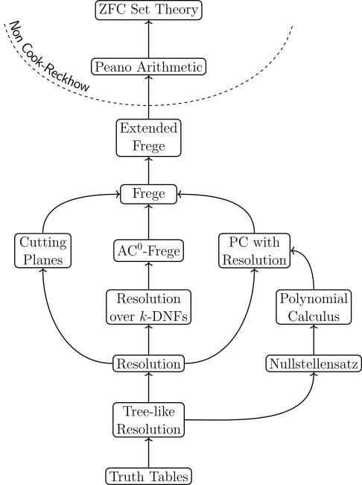
What is known?
Non-analyzable
Unless P = NP (or unless QP ⊆ NP)
Non-automatable
Unless Diffie-Hellman fails
Non-automatable
Unless P = NP (or unless ETH fails)
(Quasi) Automatable!
Analyzable!
Short Propositional Proofs are Hard to Find: a Meta-Complexity Approach - Simone Bianco

Slide 18
What is known?
Non-analyzable
Unless P = NP (or unless QP ⊆ NP)
Non-automatable
Unless Diffie-Hellman fails
Non-automatable
Unless P = NP (or unless ETH fails)
(Quasi) Automatable!
Analyzable!
From our results!
Short Propositional Proofs are Hard to Find: a Meta-Complexity Approach - Simone Bianco

Slide 19

What is known?
Non-analyzable
Unless P = NP (or unless QP ⊆ NP)
Non-automatable
Unless Diffie-Hellman fails
Non-automatable
Unless P = NP (or unless ETH fails)
(Quasi) Automatable!
Analyzable!
From our results!
Looks suspicious…
Short Propositional Proofs are Hard to Find: a Meta-Complexity Approach - Simone Bianco

Slide 20
New investigation
Automatability
Feasible interpolation
?
?
Analyzability
Autom + Analyz ⇒ P = NP
Short Propositional Proofs are Hard to Find: a Meta-Complexity Approach - Simone Bianco

Slide 21

New investigation
Automatability
Feasible interpolation
?
would imply that no proof system above Resolution is automatable (under P ≠ NP)
Analyzability
Autom + Analyz ⇒ P = NP
Short Propositional Proofs are Hard to Find: a Meta-Complexity Approach - Simone Bianco

Slide 22
New investigation
Automatability
Feasible interpolation
would imply that all disjoint NP-pairs are separable
❌
would imply that no proof system above Resolution is automatable (under P ≠ NP)
Analyzability
Autom + Analyz ⇒ P = NP
Short Propositional Proofs are Hard to Find: a Meta-Complexity Approach - Simone Bianco

Slide 23
Recap of contributions
✓
Improvements for Ref_{s}(𝝋)
?
F.I. (likely) doesn’t imply analyzability
result now holds for any s ≥ n², in Resolution and PCR
at least hard as proving that no proof system above Resolution is automatable (under P ≠ NP)
✓
Analyzability of algebraic systems
⇏
Analyzability doesn’t imply F.I.
all systems up to PCR are analyzable
unless all disjoint NP-pairs are separable
Short Propositional Proofs are Hard to Find: a Meta-Complexity Approach - Simone Bianco

Slide 24
Open problems
1
Analyzability in other systems
2
Another route to analyzability
are there other analyzable proof systems?
can analyzability be proved in a simpler way?
3
Automatability vs. Analyzability
4
An unconditional separation
we know that analyzable ⇒ NP-hard to automate, what about the converse?
can analyzability and feasible interpolation be unconditionally separated?
Short Propositional Proofs are Hard to Find: a Meta-Complexity Approach - Simone Bianco

Slide 25
Thank you for your attention!
Questions?

